Slide 1



Containers as a common deployment currency
AKS
ACI
Service Fabric
App Service
IoT
Machine Learning
…
Private Registry
Custom Apps
ISV, Packaged Apps
Azure Container Registry
Azure clients: PS, CLI, Portal, SDK)
Developer tools: VS, VS Code, VSTS
OSS clients: GitHub, Terraform, Draft, Helm, etc.,

Slide 2
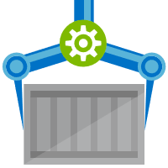


Release Management
Resource Pool
Orchestration
HOST-A
Deploy:
web:1 x3
quotes:1 x3
important:1 x4
Image Cache
3
web:1
digest: 91e
web:1
digest: 91e
Foo:
web:1 x3
quotes:1 x3
important:1 x4
web:1
digest: 91e
quotes:1
digest: u82
Container Builder
important:1
digest: 2re
important:1
digest: 2re
Container Registry
HOST-B
Image Cache
quotes:1
digest: u82
quotes:1
digest: u82
7
6
quotes:1
digest: u82
5
web:1
digest: 91e
important:1
digest: 2re
important:1
digest: 2re
important:1
digest: 2re
quotes:1
digest: u82
1
quotes:1
digest: u82
docker build –t web:1
docker build –t quotes:1
docker build –t important:1
docker push web:1
docker push quotes:1
docker push important:1
important:1
digest: 2re
important:1
digest: 2re
Image
web:1
quotes:1
important:1
2
Digests
91e
u82
2re
web:1
digest: 91e
HOST-C
quotes:1
digest: u82
4
important:1
digest: 2re
8
Image Cache
quotes:1
digest: u82
quotes:1
digest: u82
important:1
digest: 2re
important:1
digest: 2re
Notes:
Orchestrator icon from: http://cdn.marketplaceimages.windowsphone.com/v8/images/f58edb21-b20c-4315-b837-6cee21n442cd?imageType=ws_icon_large
https://git-scm.com/book/en/v2/Git-Branching-Basic-Branching-and-Merging

Slide 3
Container Lifecycle Primitives

Slide 4
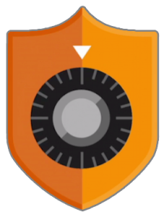



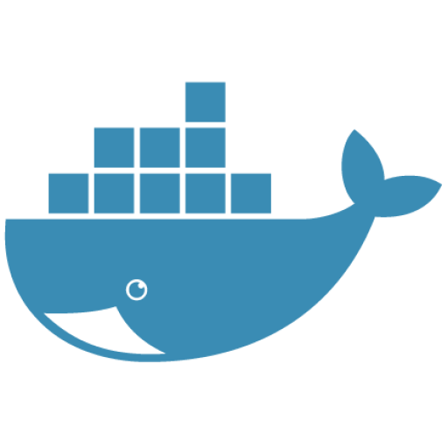




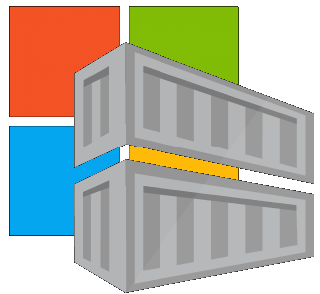
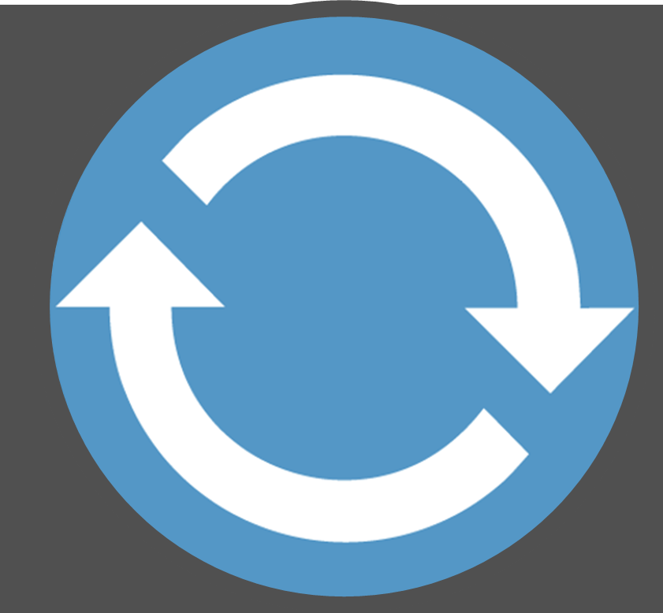

Container Lifecycle Primitives
Host agents monitor, protect and report running containers
3
Container Service
Container Instances
Source Code Control
(SCC)
Build/CI,
Integrate,
Test
CD, Deploy
7
App Services
Upon release, set released flag in ACR (ACR-Auto-purge policies)
Service Fabric
.NET
6
Base Image Index
4
8
1
2
Azure Functions
Docker Hub
ACR Tasks
Azure Container Registry
IoT
Azure Container Registry
Image Security Scanning
Secure by default
Microsoft Container Registry
Inner-Loop
Azure Batch
Run
5
Code
Validate
Debug

Slide 5





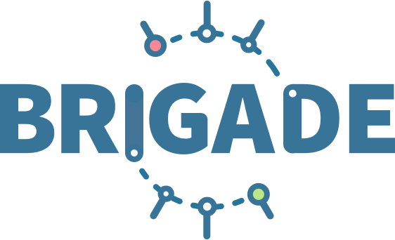

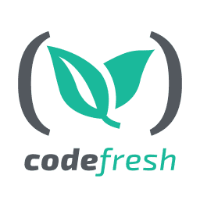
ACR Tasks: Container OS & Framework Patching
.NET
Registries
Docker Hub
MCR
ACR
Build Triggers
SCC Providers
ACR Tasks
Azure Container Registry
aka.ms/acr/tasks

Slide 6
Container Registries Secured by Default
Assuring a registry has images that are scanned and considered secure enough

Slide 7


Secured By Default
Build/Push
Azure Container Registry
Container Hosts
Quarantine Tag
Digest
Tag
91efj6
:1.0
:1.1
u82lq
:1.2
e8s1f
Shifting container scanning to the left
Partnering with:

Slide 8

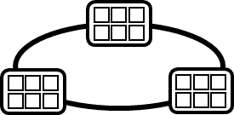
Container Service
Run, Manage
1
Release Management
Container Instances
docker push acrdemos.azurecr.io/th:1.0
Azure Container Registry
Production
environments
App Services
5
6
2
{
"id": "0d799b14-404b-4859-b2f6-50c5ee2a2c3a",
"timestamp": "2018-02-28T00:42:54.4509516Z",
"action": "push-quarantined",
"target": {
"size": 1791,
"digest": "sha256:91ef6
"length": 1791,
"repository": “th",
"tag": "1.0"},
"request": {
"id": "978fc988-1e06-49ee-bf71-4f6e331d1591",
"host": “acrdemos.azurecr.io",
"method": "PUT"}
}
{
"id": "0d799b14-404b-4859-b2f6-50c5ee2a2c3a",
"timestamp": "2018-02-28T00:42:56.4509516Z",
"action": "push",
"target": {
"size": 1791,
"digest": "sha256:91ef6
"length": 1791,
"repository": “th",
"tag": "1.0"},
"request": {
"id": "978fc988-1e06-49ee-bf71-4f6e331d1591",
"host": “acrdemos.azurecr.io",
"method": "PUT"}
}
Tag
Digest
91efj6
u82lq
e8s1f
3r2s7
Quarantine Tag
:1.0
:1.1
:1.0
:1.0
3
docker pull th@sha256:91ef6
4
Hhttp://POST/ --quarantine-remove –-image th@sha256:91ef6
or
Hhttp://POST/ --quarantine-block –-image th@sha256:91ef6
Notes:
{
"id": "0d799b14-404b-4859-b2f6-50c5ee2a2c3a",
"timestamp": "2018-02-28T00:42:54.4509516Z",
"action": "push-quarantined",
"target": {
"mediaType": "application/vnd.docker.distribution.manifest.v2+json",
"size": 1791,
"digest": "sha256:91ef6
"length": 1791,
"repository": “th",
"tag": "1.0"
},
"request": {
"id": "978fc988-1e06-49ee-bf71-4f6e331d1591",
"host": "jengademos.azurecr-test.io",
"method": "PUT",
"useragent": "docker/18.03.0-ce-rc1 go/go1.9.4 git-commit/c160c73 kernel/4.9.75-linuxkit-aufs os/linux arch/amd64 UpstreamClient(Docker-Client/18.03.0-ce-rc1 \\(windows\\))"
}
}

Slide 9


Image Signing
Assuring an image came from it’s official source

Slide 10




Content Trust
Preview – August ’18
docker push
docker pull
acr
 Content Trust Enabled,
api
api
Images
Signatures

Slide 11
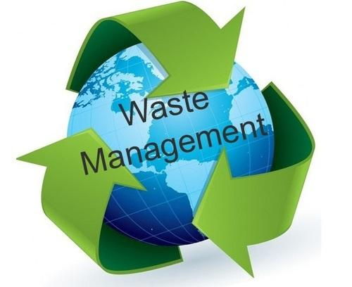
Image Policies
Await scanning, or the result of scanning

Slide 12






Image Policies
Azure Container Registry
Policies
Quarantine 7 days
Default 14 days
Release 3 years
Released
TTL 1/1/21
Quarantined TTL 1/7/18
Default
TTL 1/14/18

Slide 13
Container Lifecycle Primitives
Host agents monitor, protect and report running containers
Container Service
Container Instances
Source Code Control
(SCC)
Build/CI,
Integrate,
Test
CD, Deploy
App Services
Upon release, set released flag in ACR (ACR-Auto-purge policies)
Service Fabric
Base Image Index
Azure Functions
Docker Hub
ACR Build
Azure Container Registry
IoT
Azure Container Registry
Microsoft Container Registry
Inner-Loop
Azure Batch
Run
Code
Validate
Debug

Slide 14

Why: Azure Container Registry
Keeping your Images Network-Close
Deployed to your targets within the same data center
No ingress/egress fees, latency with better reliability
Keep Your Images Private
Stored in Azure, secured at rest, secured with AAD with the rest of your Azure resources
Geo Replicated Across the Globe
Manage global deployments as one resource, keeping the network-close
Azure Active Directory Integration
Manage registry access using AAD (individual and service auth)
Familiar Open Source CLIs
docker login, pull, push
Secure & Patched
OS & Framework patching coming with ACR Tasks

Slide 15
ACR Backlog
Production Security & Reliability Features
VNet – enlisting ACR into existing VNets
Content Trust – Supporting Signed Images
Token Based Authentication
Balance between Admin Account – Easy but not traceable and Service Principal – secure, but not as easy
Repo Level Permissions – more granular RBAC
Hyper Scale – Going Plaid
Anonymous Access – Opt-into Hyper Scale
Auto-Purge – Self management of dead space
Usage Telemetry – Who did what and when?
More Regions – China, .gov, South Africa, Korea
Developer Lifecycle Productivity
Tasks – providing container lifecycle management
Helm Repositories – Storing deployment charts
OCI – supporting the evolving container standards
Event Grid Notifications – uping the bar from Webhooks
aka.ms/acr/UserVoice
aka.ms/acr/Feedback
aka.ms/acr/Roadmap

Slide 16
Info
ACR aka.ms/acr
ACR Tasks ^{(Preview)} aka.ms/acr/tasks
ACR Geo-Replication aka.ms/acr/geo-replication
Azure Kubernetes Service: aka.ms/kubernetes
Helm: aka.ms/helm
Presentations: aka.ms/acr/presentations
Blog blogs.msdn.microsoft.com/SteveLasker
Twitter @SteveLasker
Email SteveLas@Microsoft.com

